Slide 1

THE AGILE MENTALITY
CHAPTER 27

Slide 2
Topics
Why Use Agile and Scrum?
Agile Development
  Manifesto for Agile Software Development
Scrum Methodology
  Features of Scrum
The Burndown Chart

Slide 3
Why Use Agile and Scrum?
It can be difficult to keep the game development process on track
This is especially true of
  Long term projects
  Prototypes with lots of iteration
  Projects that evolve
Agile and Scrum provide a method of project management that promotes
  Personal responsibility
  Adaptation to meet evolving needs
  Design iteration
  Deadline awareness
  Feature prioritization and focus

Slide 4
Why Use Agile and Scrum?
As a professor, the author found that Agile and Scrum improved
  The quality of games created by the students
  The level of completeness of the student projects
  The sensible scoping of student projects
  Student confidence in their development skills
    This was the most shocking
    The author believes this was tied to the personal responsibility promoted by the Scrum process
This chapter covers two project management strategies that work well together
  Agile
  Scrum

Slide 5
Agile Development
For many years, software projects were first specified and then implemented
  This was called the "waterfall method"
    Designers would create a Design Document that was handed to engineers to implement exactly
  This doesn't work very well for games
    Doesn't allow for design iteration
    Prevents prototypes from being tested fast enough
  It didn't work very well for many kinds of creative software
    Developers weren't able to creatively contribute to projects
    The lack of iteration led to sub-par software
In 2001, several developers formed the Agile Alliance to address this issue
  They collectively created the Manifesto for Agile Software Development

Slide 6
The Agile Manifesto
We are uncovering better ways of developing software by doing it and helping others do it.
Through this work we have come to value:
  Individuals and interactions over processes and tools
  Working software over comprehensive documentation
  Customer collaboration over contract negotiation
  Responding to change over following a plan
That is, while there is value in the items on the right, we value the items on the left more.
Kent Beck, et al. "Manifesto for Agile Software Development," Agile Alliance (2001)

Slide 7
The Agile Manifesto
In game development terms, these four core values become:
  Following your individual design sense & continually asking questions over following predefined rules
  Making a simple prototype and iterating over waiting until you have the perfect game idea
  Bouncing your ideas off of other creative people over worrying about who owns specific intellectual property
  Listening to and reacting to playtesters' feedback over following your original design vision
An Agile mentality keeps your game evolving as you develop it
But it's also important to keep the project on schedule

Slide 8
The Scrum Methodology
The Scrum Methodology works very well to keep Agile projects on time and on budget
The goal of Scrum is to get to a playable game as quickly as possible while allowing design flexibility
Features of Scrum
  The Scrum Team
  Feature List
  Releases and Sprints
  The Scrum Meeting
  The Burndown Chart

Slide 9
Features of Scrum
The Scrum Team
  Product Owner
    The voice of the client / players
    Wants all the coolest features to make it into the game
    Responsible for understanding the gestalt vision of the game
  Scrum Master
    The voice of reason
    Wants to make sure everyone is on-task without being overworked
    Responsible for keeping the project on schedule and cutting if necessary
    Runs the daily Scrum Meeting
  Development Team
    Everyone who is actively working on the project
    Assigned daily tasks at the Scrum Meeting
    Often also includes the Product Owner and Scrum Master
  The Product Owner and Scrum Master are natural foils

Slide 10
Features of Scrum
Backlog / Feature List
  A list of all the features that the team/client wants in the game
  Some start vague but increase in specificity
  Eventually broken down into tasks
    No individual task should be estimated to take longer than 8h (hours)
Releases and Sprints
  Product cycle is broken into Releases and Sprints
  A Release is a known time when the game will be shown to people outside the team (e.g., client, investors, playtesters)
  A Sprint is a version of the game along the way to a release
    Usually a Sprint lasts 1-4 weeks
    The game must be playable and bug-free at the end of each sprint
      In the best case, the game should be playable at the end of each day
  Each Sprint has its own Sprint Backlog of features that will be complete by the end of the Sprint

Slide 11
Features of Scrum
The Scrum Meeting
  A Scrum Meeting occurs every morning during a Sprint
  It is a 15-minute stand-up meeting to keep everyone on track
    Literally everyone stands through the entire meeting to keep it short
  The meeting is run by the Scrum Master
  She asks each person on the team 3 questions:
    What did you accomplish since yesterday?
    What do you plan to accomplish today?
    What obstacles might get in your way?
  This ensures that everyone on the team is aware of overall progress
  Also enforces personal responsibility for tasks
  Any questions that come up are recorded and tabled for discussion after the meeting
  All progress is tracked on a shared Burndown Chart

Slide 12
Features of Scrum
The Burndown Chart
  Tracks team progress towards a Sprint deadline
  Compares total estimated time for tasks against daily progress (the Burndown Rate)
  Uses this information to predict whether or not the team will complete the project on time

Slide 13
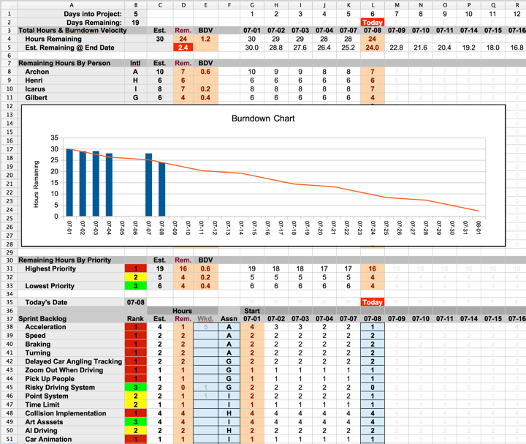
Anatomy of a Burndown Chart

Slide 14
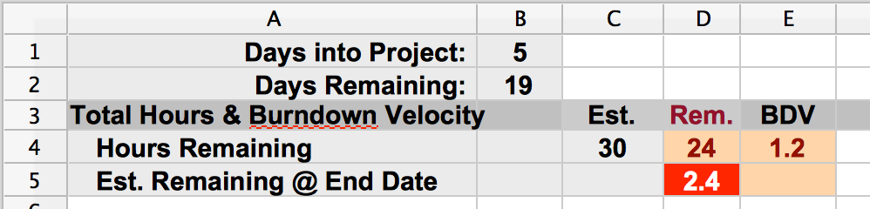
Anatomy of a Burndown Chart

Slide 15
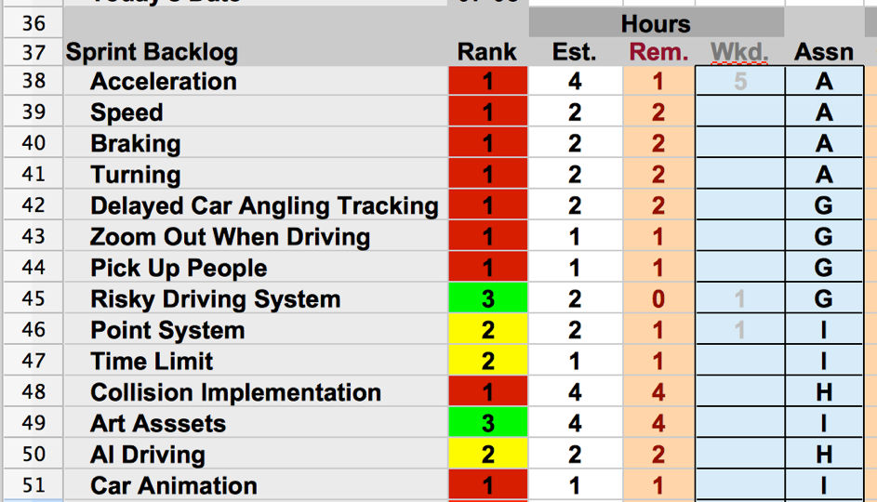
Anatomy of a Burndown Chart

Slide 16
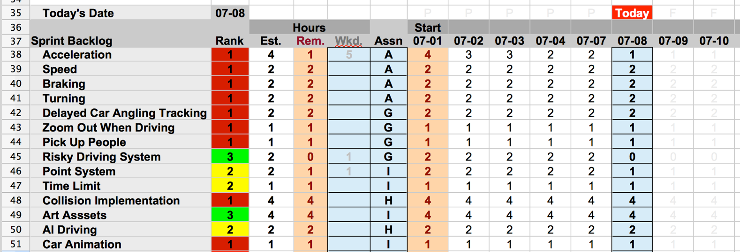
Anatomy of a Burndown Chart

Slide 17
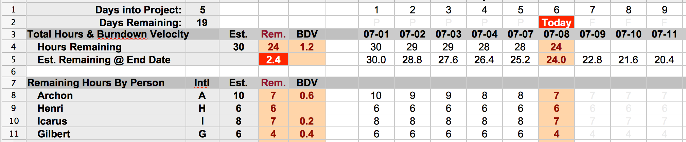
Anatomy of a Burndown Chart

Slide 18
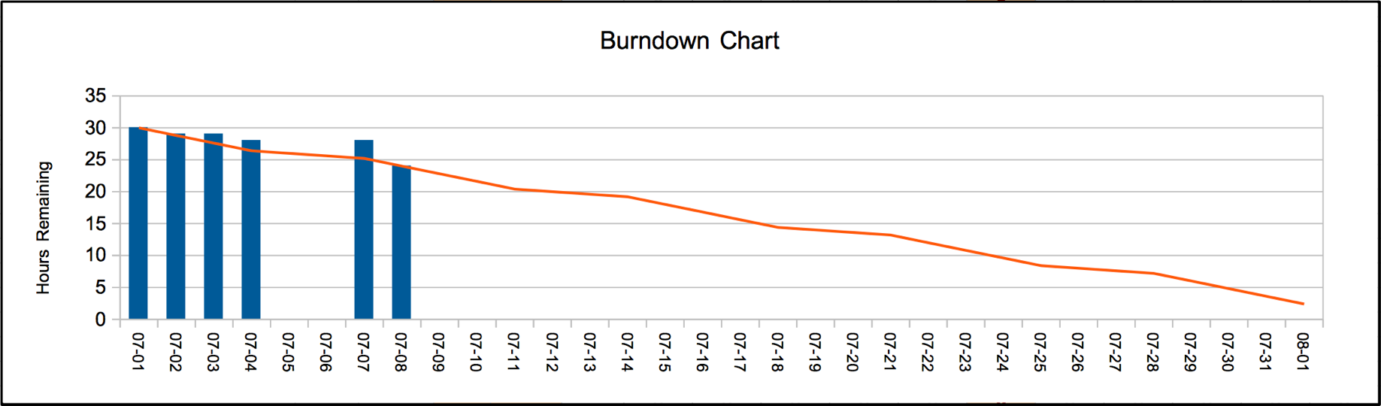
Anatomy of a Burndown Chart

Slide 19
ESTIMATED HOURS
Team estimates hours to complete each task
  Uses their best guess
When burning down a task, mark down hours based on percent of task that remains
  Not actual hours worked!!!
Example: You estimate a task will take 4h to complete
  You work 6h on the task, but it's 50% complete
    Mark 2h remaining on the Burndown Chart
  Alternatively, you work 1h on the task, but it's 75% complete
    Mark 1h remaining on the Burndown Chart
Always think in terms of original estimated hours

Slide 20
The Burndown Chart
Most useful on 1-4 week Sprints
Also most useful for teams that do about the same amount of work each day
  If the team changes their rate of work drastically, the Burndown Chart will not adjust to reflect this

Slide 21
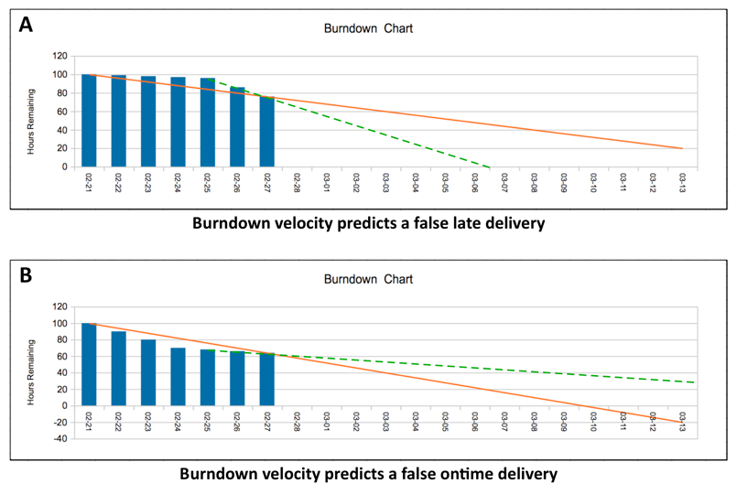
The Burndown Chart

Slide 22
The Burndown Chart
Most useful on 1-4 week Sprints
Also most useful for teams that do about the same amount of work each day
  If the team changes their rate of work drastically, the Burndown Chart will not adjust to reflect this
  This is only an issue for teams that make drastic changes to their work per day

Slide 23
Chapter 27 – Summary
The Agile mentality and Scrum are fantastic tools for developers of games and game prototypes
At large companies, they are generally used in the Preproduction phase of game development
  Switch to a more "waterfall" approach for Production phase once the core gameplay and design have been discovered through Agile and Scrum
The Burndown Chart is the best tool the author has found for tracking small, agile projects
Next: Part III – Game Prototype Examples and Tutorials
  Eight different game tutorials for everything from a Space Shooter to Card Games to a Word Game
  Followed by an Appendix of Useful Concepts for game dev

